Slide 1

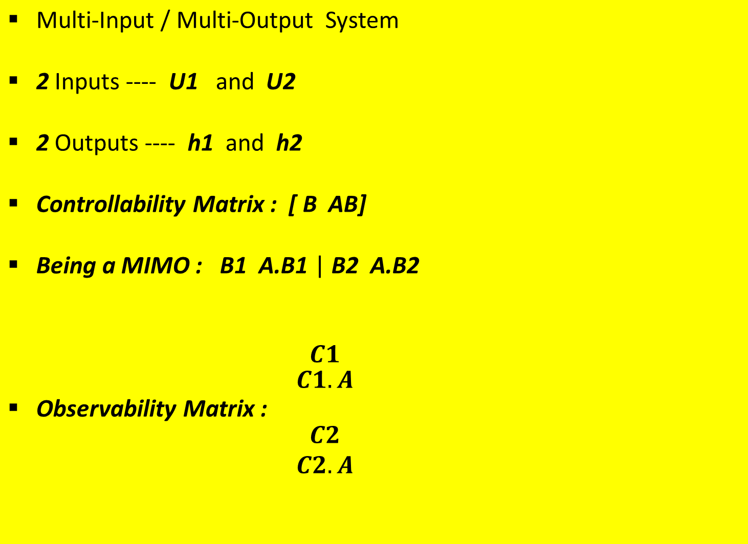
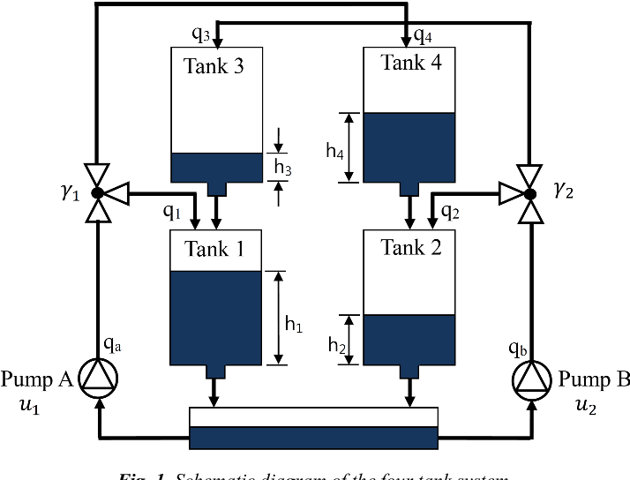
Lecture No. 18
PF -- Four-Tank Problem
Performance –
PF vis-à-vis KF

Slide 2
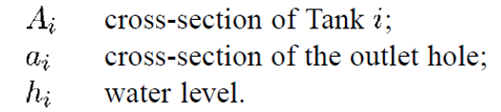
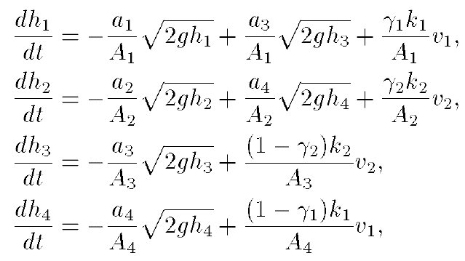
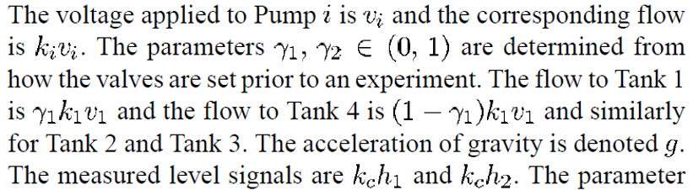
The 4-Tank Problem

Slide 3

Initialisation, t = 0; (Prior Step)
For i = 1, …., N, sample x(0) ~ p{x(0)} & set t = 1
Importance Sampling
  Prediction Step
  For i = 1,…,N, sample x(t,i) ~ p{x(t)|x(t-1, i)}
  Likelihood Step
  For i = 1,…,N, evaluate importance weights : w(t,i) = p{z(t)|x(t,i)
  Normalise the Importance Weights
Selection
  Update Step/Resampling Step
  Resample with replacement, according to Importance Weights
  Set t = t + 1 and return to Prediction Step

Slide 4
% initialization of all the parameters of the four tank system
clc; clear; close all;
A1 = 28; %(cm^2)
A2 = 32;
A3 = 28;
A4 = 32;
a1 = 0.071; a3 = 0.071; %(cm^2)
a2 = 0.057; a4 = 0.057;
kc = 0.5; % (V/cm)
g = 981; %(cm/s^2)
gamma1 = 0.7; gamma2 = 0.6; % constants, determined from valve position
k1 = 3.33; k2 = 3.35; %[cm^3/Vs]
kc = 0.5; % [V/cm]
v1 = 3; v2 = 3; % (V)
h0 = [12.4; 12.7; 1.8; 1.4];

Slide 5
Initialisation, t = 0; (Prior Step)
For i = 1, …., N, sample x(0) ~ p{x(0)} & set t = 1
Importance Sampling
  Prediction Step
  For i = 1,…,N, sample x(t,i) ~ p{x(t)|x(t-1, i)}
  Likelihood Step
  For i = 1,…,N, evaluate importance weights : w(t,i) = p{z(t)|x(t,i)
  Normalise the Importance Weights
Selection
  Update Step/Resampling Step
  Resample with replacement, according to Importance Weights
  Set t = t + 1 and return to Prediction Step

Slide 6
Prior
For a state vector of dimension (1 x 1)
    x(:,1) = sqrt(P0) * randn(N,1)
    We obtain N samples (particles)
For a state vector of dimension (n x 1)
    L = cholesky (P0)
    x = randn(N, n) * L + ones(N, n) * x (n x 1)
    We obtain x of order (N x n)

Slide 7
% initialization of the states and covariances
x0 = h0;
x_post = x0;
C = [kc 0 0 0; 0 kc 0 0];
n = 4; % number of states
P0 = 10^5 * eye(4); % initial covariance
N = 500; % number of particles
Initialization
Prior
L = chol(P0);
x0 = (x0 * ones(1,N))' + randn(N,n) * L; %Adding covariance to each particle
% Initialization of the states
x1_post = x0(:,1);
x2_post = x0(:,2);
x3_post = x0(:,3);
x4_post = x0(:,4);

Slide 8
% Process Noise
Q = 100 * eye(4); % process noise
w = chol(Q) * randn(n,N); % for roughening of the prior
w1 = w(1,:);
w2 = w(2,:);
w3 = w(3,:);
w4 = w(4,:);
Considering Process Noise
Roughening of the Prior
% Prior roughening
x1_post = x1_post + w1';
x2_post = x2_post + w2';
x3_post = x3_post + w3';
x4_post = x4_post + w4';

Slide 9
Initialisation, t = 0; (Prior Step)
For i = 1, …., N, sample x(0) ~ p{x(0)} & set t = 1
Importance Sampling
  Prediction Step
  For i = 1,…,N, sample x(t,i) ~ p{x(t)|x(t-1, i)}
  Likelihood Step
  For i = 1,…,N, evaluate importance weights : w(t,i) = p{z(t)|x(t,i)
  Normalise the Importance Weights
Selection
  Update Step/Resampling Step
  Resample with replacement, according to Importance Weights
  Set t = t + 1 and return to Prediction Step

Slide 10
Prediction
For a state vector of dimension (1x1)
    w ~ sqrt (Q) * randn(N,1)
    x(k-) = fn. { x, u } + w
    We obtain predicted x as (N x 1) vector
For a state vector of dimension (n x 1)
    w ~Cholesky (Q) * randn(N x n)
    For i = 1 to N,
      x1(k-) = fn. {x, u} + w(i, 1)
      :
      xn(k-) = fn. {x, u} + w(i, n)
    We obtain predicted x as (N x n) vector
k-1
k
k+1

Slide 11
Prediction Step
% Prediction equation
for i = 1:N
x1_pri(i) = -a1/A1*sqrt(2*g*x1_post(i)) + a3/A1*sqrt(2*g*x3_post(i)) + (gamma1*k1*v1)/A1
+ w1(i);
x2_pri(i) = -a2/A2*sqrt(2*g*x2_post(i)) + a4/A2*sqrt(2*g*x4_post(i)) + (gamma2*k1*v2)/A2
+ w2(i);
x3_pri(i) = -a3/A3*sqrt(2*g*x3_post(i)) + (1 - gamma2)*k2*v2/A3 + w3(i);
x4_pri(i) = -a4/A4*sqrt(2*g*x4_post(i)) + (1 - gamma1)*k1*v1/A4 + w4(i);
end
x_pri = abs(x_pri);
x1_pri = abs(x1_pri);
x2_pri = abs(x2_pri);
x3_pri = abs(x3_pri);
x4_pri = abs(x4_pri);

Slide 12
Initialisation, t = 0; (Prior Step)
For i = 1, …., N, sample x(0) ~ p{x(0)} & set t = 1
Importance Sampling
  Prediction Step
  For i = 1,…,N, sample x(t,i) ~ p{x(t)|x(t-1, i)}
  Likelihood Step
  For i = 1,…,N, evaluate importance weights : w(t,i) = p{z(t)|x(t,i)
  Normalise the Importance Weights
Selection
  Update Step/Resampling Step
  Resample with replacement, according to Importance Weights
  Set t = t + 1 and return to Prediction Step

Slide 13

Likelihood/Importance Weights
Considering an Exponential pdf
    v = z* ones(N x 1) – C * x (predicted)
        (1 x n) (n x N)
    For i = 1 to N
Normalising the Weights
    For i = 1 to N
      Wt (i) = q(i) / sum(q)

Slide 14
% Importance Weights (Likelihood Function)
z1 = 12.4;
z2 = 12.7;
z = [z1; z2];
z_true = z * ones(1,N);
R = 10 * eye(2);
z_est = C*x_pri;
v = z_true - z_est;
for i = 1:N
q(i) = exp(-0.5 * (v(:,i)' * inv(R) * v(:,i)));
end
Likelihood --- Evaluating the Weights
% Normalizing the weights
for i = 1:N
wt(i) = q(i)/sum(q);
end

Slide 15
Initialisation, t = 0; (Prior Step)
For i = 1, …., N, sample x(0) ~ p{x(0)} & set t = 1
Importance Sampling
  Prediction Step
  For i = 1,…,N, sample x(t,i) ~ p{x(t)|x(t-1, i)}
  Likelihood Step
  For i = 1,…,N, evaluate importance weights : w(t,i) = p{z(t)|x(t,i)
  Normalise the Importance Weights
Selection
  Update Step/Resampling Step
  Resample with replacement, according to Importance Weights
  Set t = t + 1 and return to Prediction Step

Slide 16



Resampling
Dist. Of
Predicted States
Corresponding
Weights
Posterior Density
Function after
Re-sampling
Particles having
Low Weights
are Rejected &
Particles having
High Weights
are Retained/
Replicated
Shape of the Density
Function before
Re-sampling
(Predicted Estimates)
Shape of the Density
Function after
Re-sampling
(Updated Estimates)

Slide 17
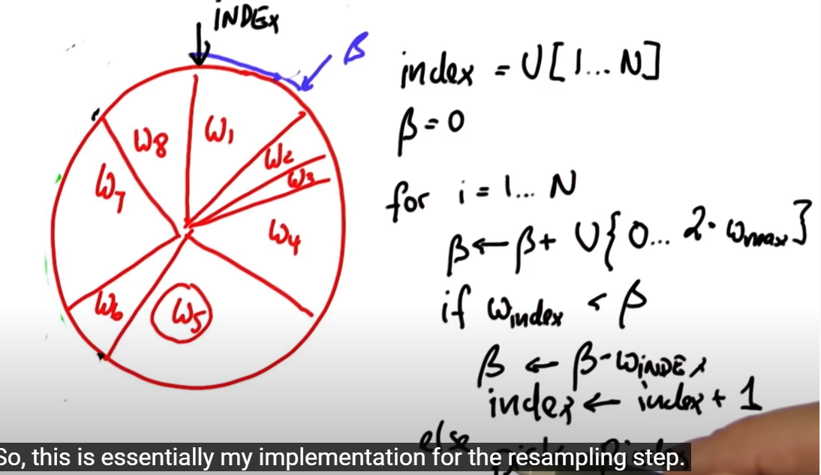
Resampling
M = length(wt);
Q = cumsum(wt);
indx = zeros(1, N);
T = linspace(0,1-1/N,N) + rand/N;
i = 1; j = 1;
while(i<=N && j<=M),
while Q(j) < T(i)
j = j + 1;
end
indx(i) = j;
x1_post(i) = x1_pri(j);
x2_post(i) = x2_pri(j);
x3_post(i) = x3_pri(j);
x4_post(i) = x4_pri(j);
i = i + 1;
end

Slide 18
x1_pri_cum = cumsum(x1_pri);
x2_pri_cum = cumsum(x2_pri);
x3_pri_cum = cumsum(x3_pri);
x4_pri_cum = cumsum(x4_pri);
x1_post_cum = cumsum(x1_post);
x2_post_cum = cumsum(x2_post);
x3_post_cum = cumsum(x3_post);
x4_post_cum = cumsum(x4_post);
x1_est = mean(x1_post);
x2_est = mean(x2_post);
x3_est = mean(x3_post);
x4_est = mean(x4_post);
x_post = [x1_post x2_post x3_post x4_post];
Evaluating the Estimate -- Centroid

Slide 19
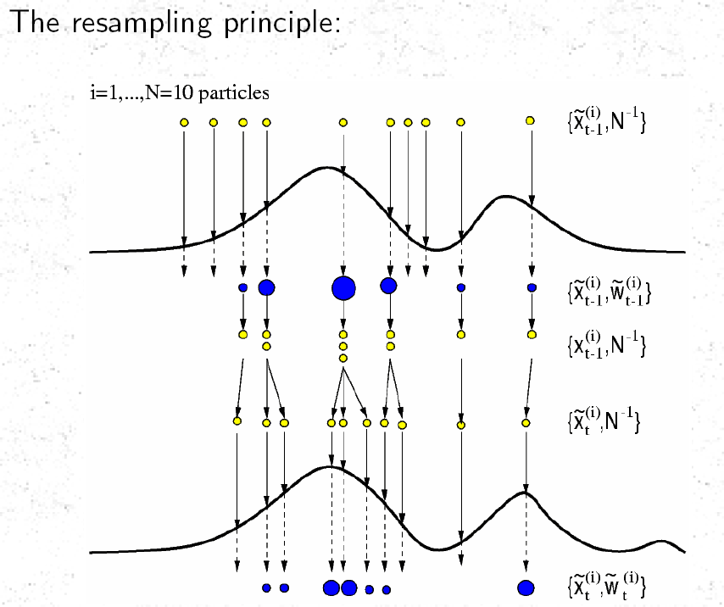

Observations, Y
Weights, w_{i}

Slide 20
Initialisation, t = 0; (Prior Step)
For i = 1, …., N, sample x(0) ~ p{x(0)} & set t = 1
Importance Sampling
  Prediction Step
  For i = 1,…,N, sample x(t,i) ~ p{x(t)|x(t-1, i)}
  Likelihood Step
  For i = 1,…,N, evaluate importance weights : w(t,i) = p{z(t)|x(t,i)
  Normalise the Importance Weights
Selection
  Update Step/Resampling Step
  Resample with replacement, according to Importance Weights
  Set t = t + 1 and return to Prediction Step

Slide 21
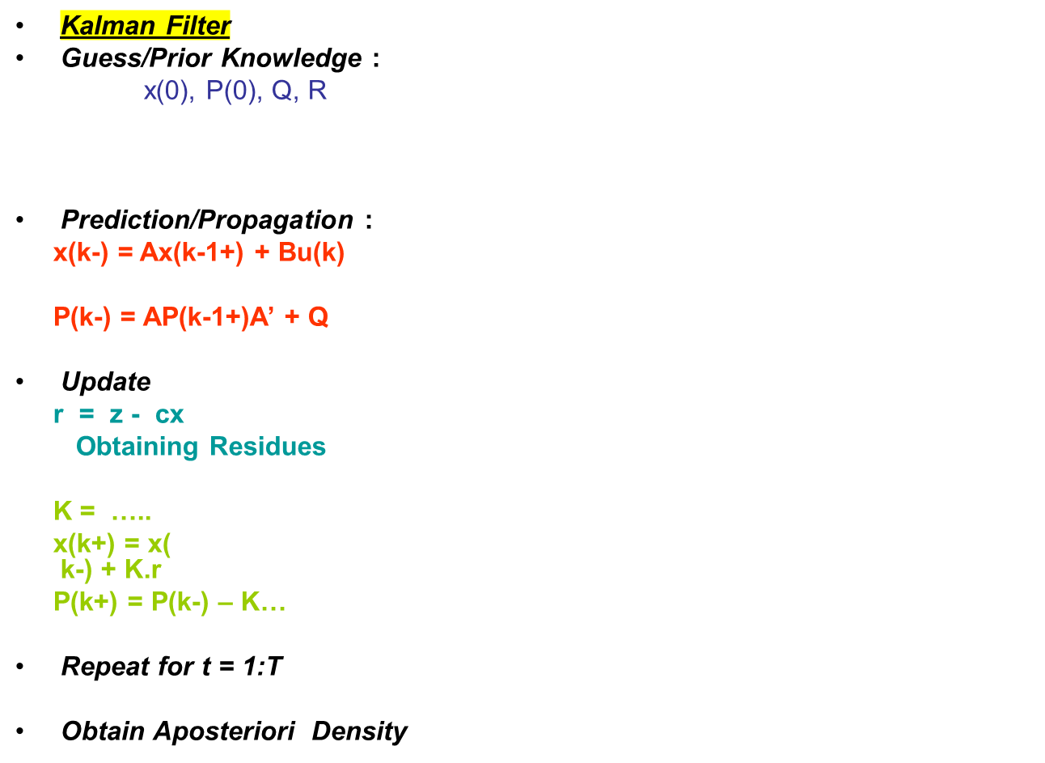
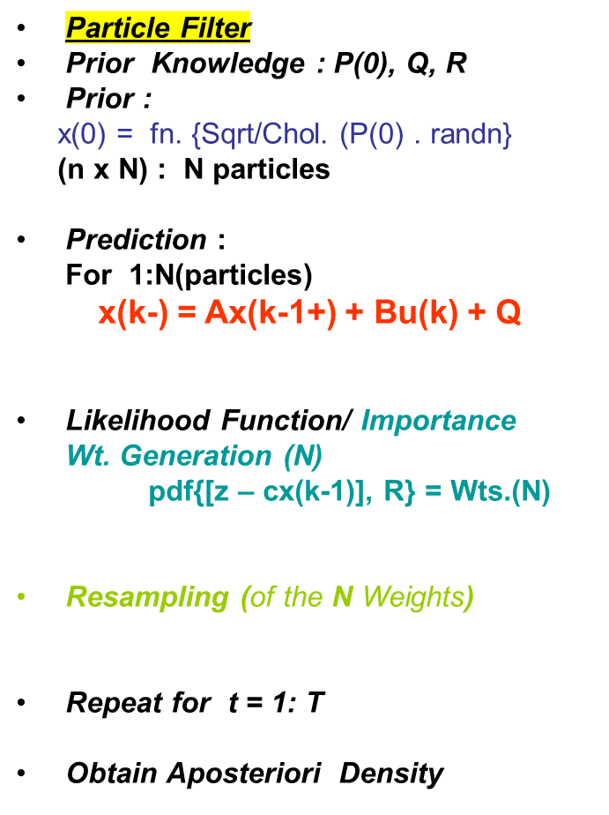
Comparing Particle Filter and Kalman Filter

